Slide 1
CELL SPECIALIZATION - I
LESSON 7 ON CELLS

Slide 2
ARE THESE PLANT OR ANIMAL CELLS?
HOW CAN YOU TELL?
SIZE
SHAPE
INTERNAL PARTS
EXTERNAL PARTS?
Notes:
http://www.thaidentist.org/human-muscle-cells/ - picture of types of cells – nerve, muscle, bone, gland, blood and reproductive

Slide 3
WHY ARE THERE DIFFERENT TYPES OF CELLS?
- CELL SPECIALIZATION
DIVISION OF LABOUR
CELL DIFFERENTIATION
Notes:
http://www.thetahealth.com/human-body-cells/

Slide 4
WHERE DO DIFFERENT CELLS COME FROM?
Notes:
http://www.aristoloft.com/wp-content/uploads/2014/10/What-Is-a-Stem-Cell.jpg

Slide 5
RECAP OF PREVIOUS LESSONS
A cell is the _________________________________________________________________.
All living organisms are able to – GRIMNER – grow, reproduce, irritability (sense), move, nutrition, excrete and respire (make energy)
animals are unicellular or multicellular?
Cell specialization occurs because the organism is so large and there is a division of labour. One cell cannot carry out all functions quick enough or effectively.
All cells are small because
of the ratio between surface area and volume;
as cell size increases, the SA:V ratio decreases meaning it becomes more difficult for substances to enter and exit the cell quickly
What size or surfaces is/are best then?
large surface area to volume ratio – that is – small cells or cells with folds or projections from the surface.

Slide 6
WHAT IS CELL SPECIALISATION?
When a cell is modified from the general structure – parts removed or added.
The specialized cell now performs one major task that will contribute to the proper functioning of the organism.
Remember, in multicellular organisms, individual cells cannot get bigger than a certain size (the inside would be too far from the outside).
So in order for an organism to grow, it must increase the number of cells making up its body.
For innermost cells to get useful substances and remove wastes, the cells will have to distribute and organize these tasks among themselves – Division of Labor.
Similar structured and functioning cells can thus be grouped together into a tissue (see lesson 9).
Let us examine some specialized cells found in animals

Slide 7
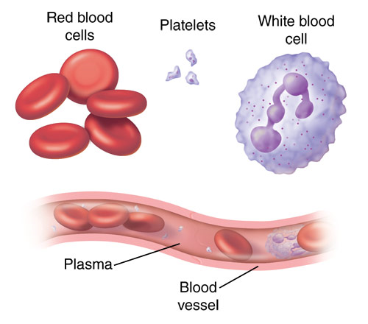
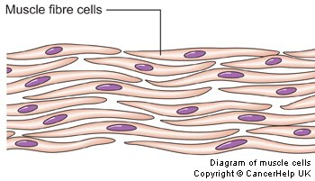
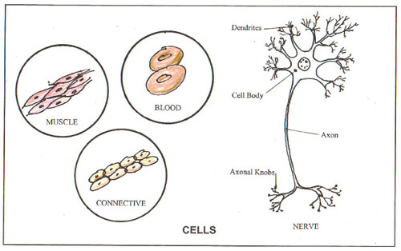
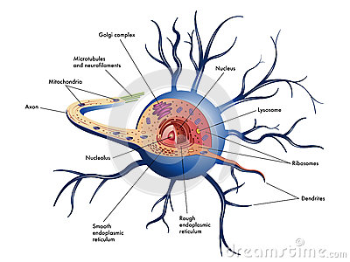
LOOK AT THESE CELLS.

Slide 8
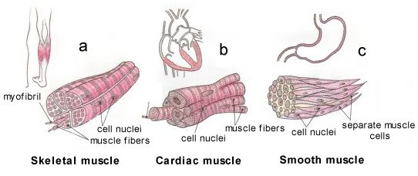
MUSCLE CELLS - TYPES

Slide 9
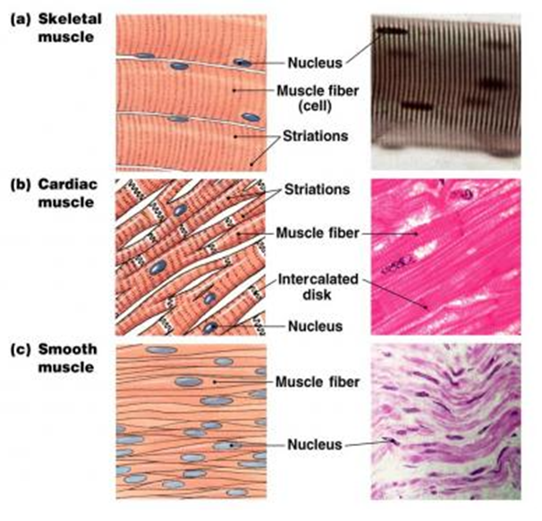
MUSCLE CELLS
MAJOR FUNCTIONS | HOW IT IS SPECIALIZED
ALL - allow for movement | ALL – have numerous mitochondria for energy to contract.
Skeletal muscle – attached to bones – produce movement at joints | long and cylindrical, multinucleated and heavily striated
Cardiac muscle –causes the heart to beat | Special membranes between cells, a single nucleus, lightly striated
Smooth muscle – in hollow organs or tubes causes peristalsis and slow, involuntary contraction | individual cells tapered at the ends

Slide 10
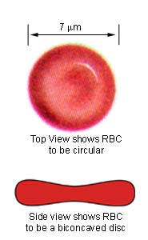
RED BLOOD CELLS
HOW IT IS SPECIALIZED
1. Contain haemoglobin – a red pigment that readily binds oxygen
2. Has no nucleus – more space to pack in haemoglobin
3. Relatively small – to squeeze through narrow capillaries (blood vessels which go to every cell of the body)
4. Biconcave shape – increases the surface area for oxygen to diffuse in and out
5. Flexible – to squeeze through capillaries – narrow blood vessels
Transport oxygen around the body from the lungs to cells that need it.
Note: can only live 4 months (has no nucleus); but more is made in the bone marrow 9000 million per hour.

Slide 11
NERVE CELLS
Rapid conduction of messages throughout the body.
Irritability – Nerve cells allow the body to make sense of the environment and respond
HOW NERVE CELLS ARE SPECIALIZED FOR THEIR FUNCTION
They are long
They are branched at their ends – to communicate with other nerve cells
They have different parts – the cell body, dendrites and an axon
Some axons of nerve cells are surrounded by other cells for insulation – makes impulses move faster
Neurotransmitter chemicals released from ends of the cells can cause communication with other nerve cells

Slide 12
WORKSHEET 1 - VENN DIAGRAM
INSTRUCTIONS:
Fill in the venn diagram comparing the structures in a neuron – a nerve cell with an animal and plant cell.
Copy and paste the picture into paint and then use text to add words to the spaces.

Slide 13
WORKSHEET 2 -
Draw an outline of a nerve cell
Give two ways it is specialized
What 2 features of red blood cells help them to transport as much oxygen as possible?
Give two reasons why an animal is made up of specialized cells.

Slide 14
HOMEWORK
GO ON THE INTERNET AND RESEARCH THE FOLLOWING CELLS AND THEIR SPECIALIZATIONS
1. Sperm cell
2. Phagocytes (a kind of white blood cell)
3. Ciliated epithelial cells
You may use the web resource
http://www.slideshare.net/fatimaalzahraa/specialized-cells-biology

