Slide 1
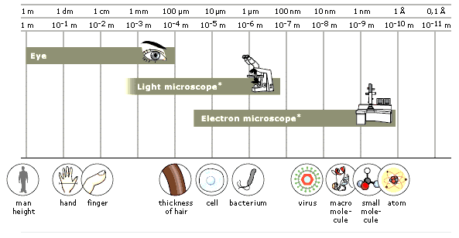
CELLS
LESSON 2 – VIEWING CELLS WITH A MICROSCOPE

Slide 2
OBJECTIVES
Explain the basic functions of a light microscope
Compare light and electron microscopes in terms of equipment itself and specimens viewed
List the parts of the light microscope

Slide 3
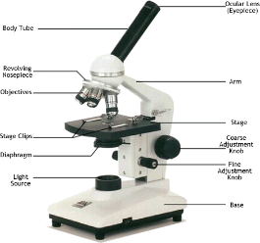
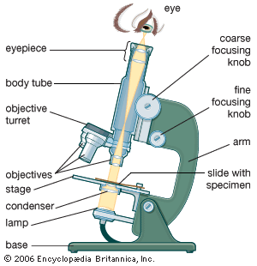
INTRODUCTION
The cell is the basic structural and functional unit of all living things – plants, animals, bacteria and fungi.
They are so small – microscopic that they cannot be seen with the naked eye but only with the aid of a microscope.
What can you see with the different types of microscopes?
The human eye is capable of distinguishing objects down to a fraction of a millimeter.
With the use of light and electron microscopes it is possible to see down to an angstrom and study everything from different cells and bacteria to single molecules or even atoms.

Slide 4
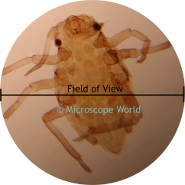
TYPES OF MICROSCOPES
There are two major types of microscopes
The light microscope or compound microscope
The electron microscope (of which there are different types)
Visit the following sites for more information
http://www.microbehunter.com/electron-microscopes-vs-optical-light-microscopes/
http://universe-review.ca/R11-13-microscopes.htm

Slide 6
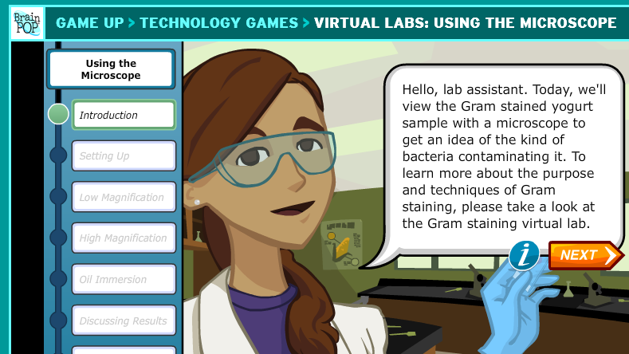
USING THE LIGHT MICROSCOPE
Go online and try out the https://www.brainpop.com/games/virtuallabsusingthemicroscope/ - virtual microscope use

Slide 7
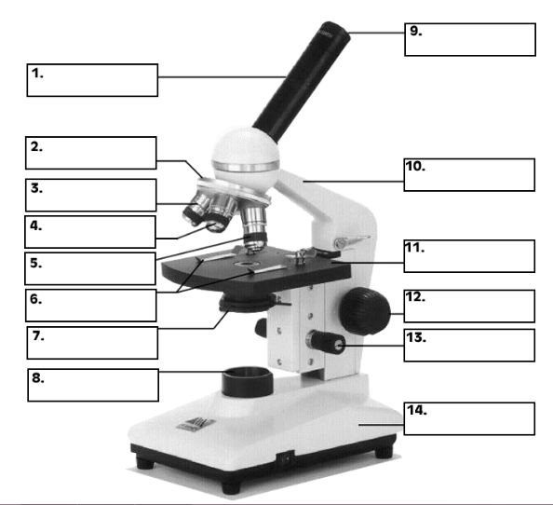
MICROQUIZ
Using the microquiz given, label the parts of the light microscope
Keep and stick the paper into your notebooks

Slide 8
SLIDES
In order to view specimens with the microscope slides are made
A blank slide is a thin, flat piece of glass
A thin slice of a specimen is placed (mounted) on the slide to view
Usually a little square called a cover-slip is placed over the specimen, forming a sandwich – this is so the specimen will not move or dry out.
Cover slips are smaller and thinner than the blank slide.
Slides can be readymade permanent or you can make your own temporary ones.

Slide 10
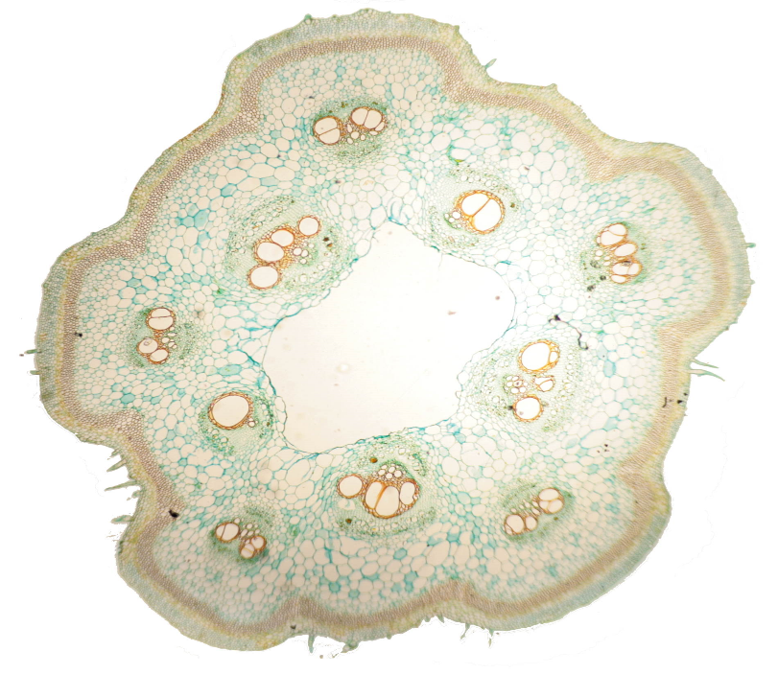
SLIDE 1 -
Look at the first slide
Write down in your book a description as follows
Name of slide: pumpkin stem at x4
Shapes of cells:
Colours of cells:
Plant/ Animal specimen?

Slide 11
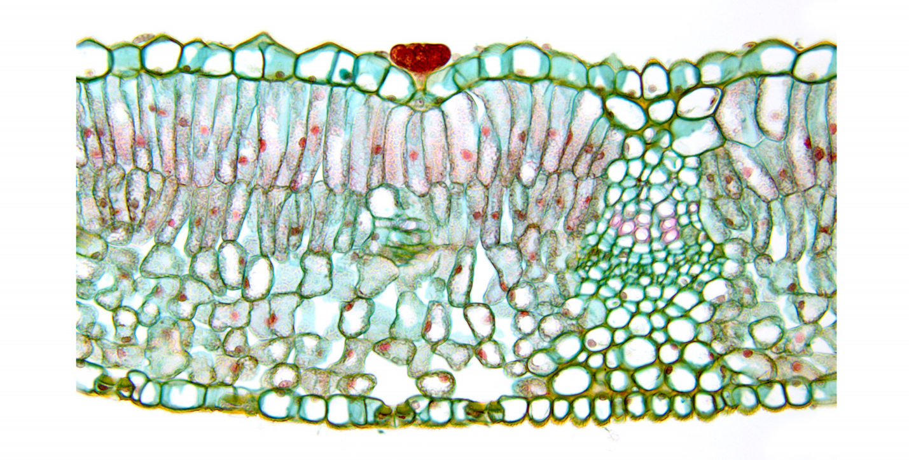
SLIDE 2 -
Look at the first slide
Write down in your book a description as follows
Name of slide:
Shapes of cells:
Colours of cells:
Plant/ Animal specimen?

Slide 12
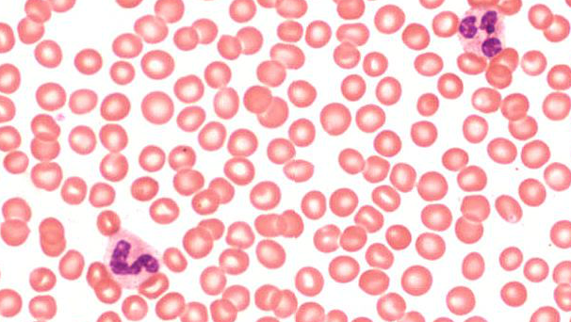
SLIDE 3 -
Look at the first slide
Write down in your book a description as follows
Name of slide:
Shapes of cells:
Colours of cells:
Plant/ Animal specimen?

Slide 13
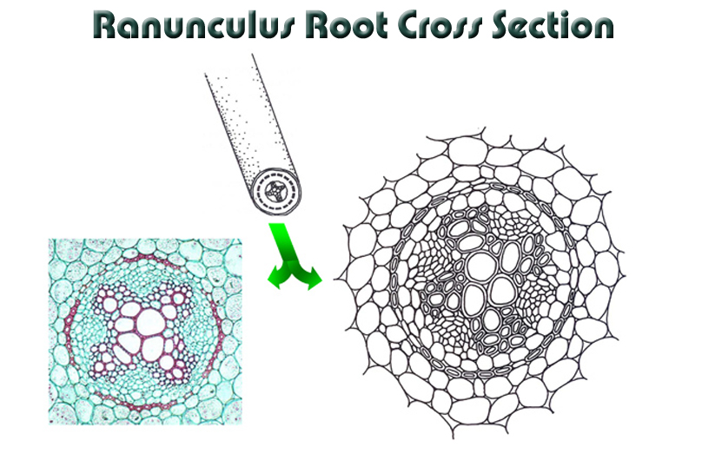
SLIDE 4 -
Look at the first slide
Write down in your book a description as follows
Name of slide:
Shapes of cells:
Colours of cells:
Plant/ Animal specimen?

Slide 14
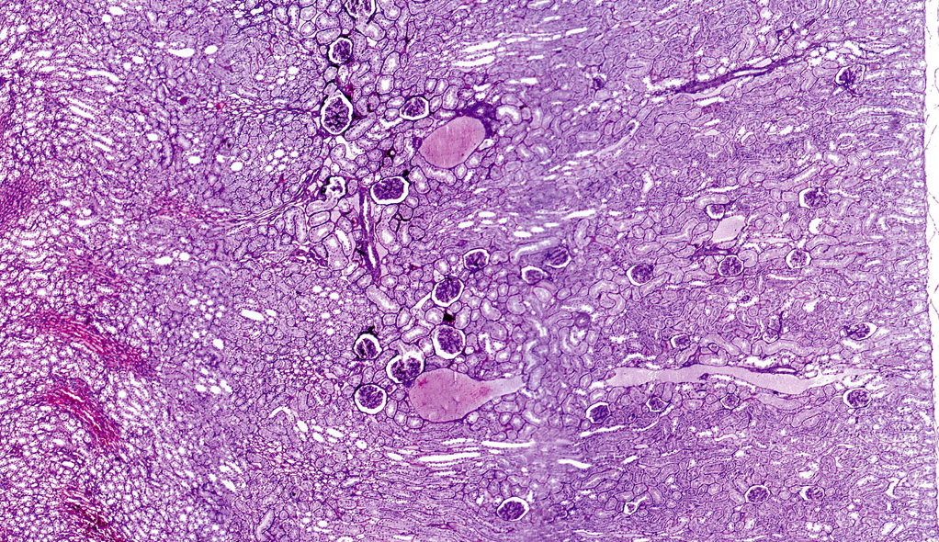
SLIDE 5 -
Look at the first slide
Write down in your book a description as follows
Name of slide:
Shapes of cells:
Colours of cells:
Plant/ Animal specimen?
http://medcell.med.yale.edu/histology/urinary_system_lab/kidney.php

Slide 15
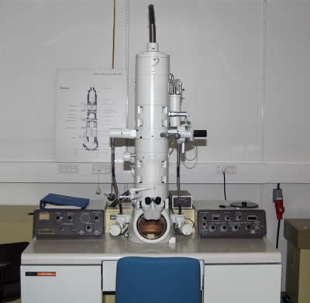
ELECTRON MICROSCOPE
Electron microscopes are used to view specimens in even more details. It can be used to see inside cells, not just the outline
There are more than one types of electron microscope
The Transmission Electron Microscope (TEM) was developed in 1931.
The first Scanning Electron Microscope (SEM) debuted in 1942

Slide 17
PROJECT - ASSIGNMENT
Use your laptop to do research and type up the answers to the following questions:
Use Microsoft word. Make sure to add a cover page with your name, class and subject.
Compare a light and an electron microscope in a table format.
How do microscopes help scientists and doctors? Provide an example of how the microscope has greatly enhanced scientific knowledge.
How might the SEMs help diagnose and treat diseases?
Can you determine a cell’s function from its size and shape?
Which images were most interesting and why?
Were there any differences between plant and animal cells? Describe or draw them.
Adapted from http://www.discoveryeducation.com/teachers/free-lesson-plans/virtual-electron-microscope.cfm

Slide 18
Slides online! - Histology
http://www.histologyguide.org/01_Introduction/Chapter.html#The_Cell – scroll down to the section marked Morphology
Click on MH 002 Cells and Tissues – there is a clickable picture that zooms in step by stem. – May need a fast speed of connection for the webpage to load properly.

