Slide 1
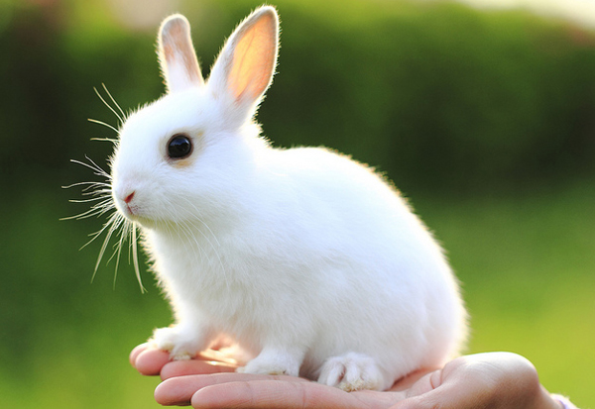
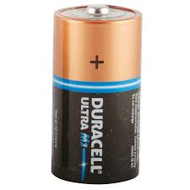
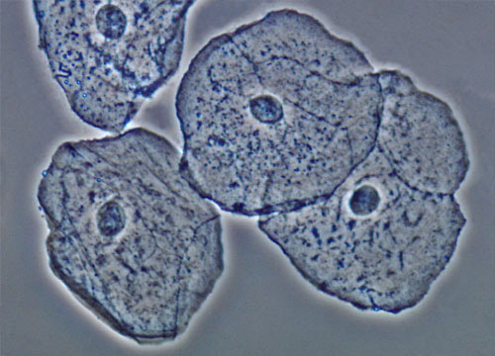
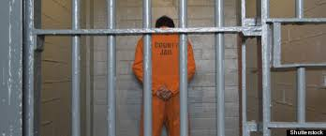
Lets Guess Today’s Lesson

Slide 2
YOU ARE RIGHT !!!
ANIMAL CELLS

Slide 3
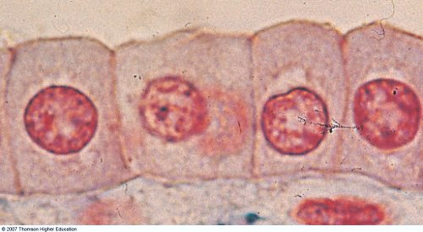
What are Animal Cells Made up of?
All cells are made up of different parts.
Each part has a different function.
The parts in the Animal cells are:
Cell Membrane
Cytoplasm
Nucleus
Vacuoles/ Lysosomes
Mitochondria
Ribosomes
Golgi apparatus
Endoplasmic reticulum

Slide 4
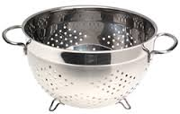
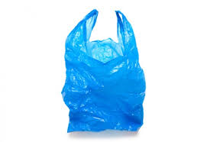
Cell Membrane

Slide 5
Cell Membrane Function
A partially permeable membrane
which allows certain materials
to move in and out of the cell.

Slide 6
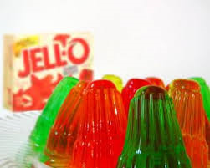
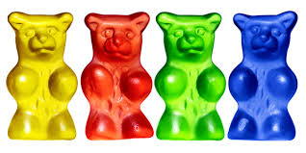
Cytoplasm

Slide 7
Cytoplasm Function
Jelly-like substance that all organelles are suspended in.
Also many chemical reactions take place here.
An organelle is a specialised sub-structure found in a cell like the:

Slide 8
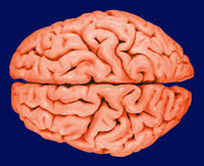
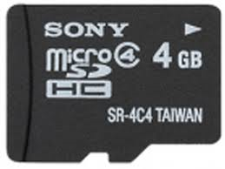
Nucleus

Slide 9
Nucleus Function
This is the brain of the cell it controls all chemical reactions in the cell.
Has instructions on chromosomes found here.

Slide 10
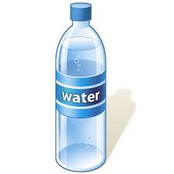
Vacuoles

Slide 11
Vacuole Function
Tiny spaces containing water, food particles, waste and other substance.
They are small and numerous.
They are temporary structures in animal cells

Slide 12
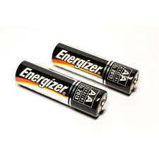
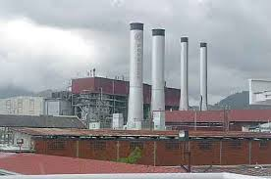
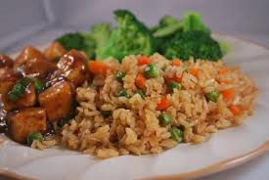
Mitochondria

Slide 13
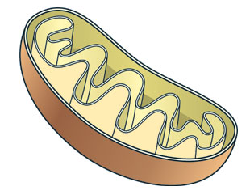
Mitochondria Function
Make energy for the cell
Rod shaped structures that use oxygen to release the chemical energy stored in food during cell respiration.

Slide 14
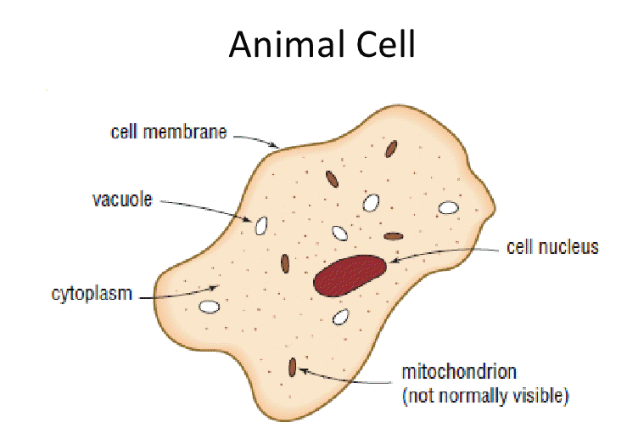
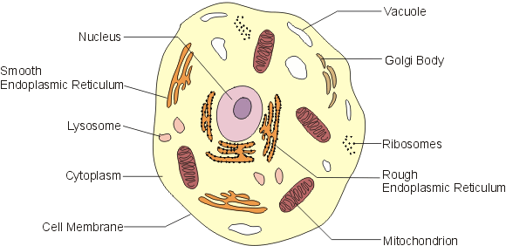
Animal cell

Slide 15
OTHER PARTS/ ORGANELLES
There are some other parts in the animal cell that we have not discussed.
Use your textbook and the internet to find out the functions of these other parts
Lysosomes
Ribosomes
Golgi apparatus
Endoplasmic reticulum

