Slide 1
SPECIES & speciation
Miss Amy Heeraman Form 5 Biology Friday 30th January 2015

Slide 2
VIDEO
INTRODUCTION
https://www.youtube.com/watch?v=Q2vsG77PZ80 – video 1 on speciation
Look at the video.

Slide 3
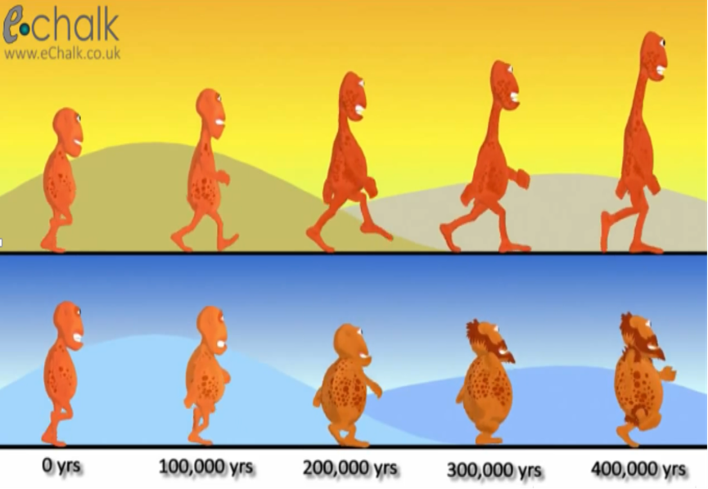
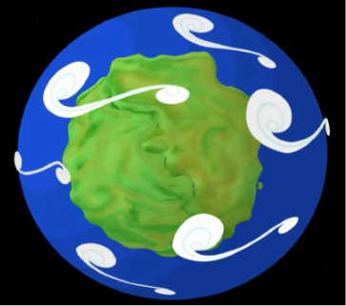

VIDEO DISCUSSION
How many races of lumptys were there at the start?
How many races were there at the end? How can you tell?
What initially caused the change in the races?
How were the races different from each other and the orginal lumptys?
How long did they take to change completely into two races?
What term did they use to describe this change?
One race
Two races – they look different
The land mass split into two
One was tall thin, the other was short and round. Both were different to the original.
400 000 years
Speciation (Allopatric speciation)

Slide 4
TODAY’S OBJECTIVES
At the end of today’s lesson, you should be able to:
Explain what is meant by the term species.
- biological species concept.
- exceptions to the biological species concept
2. Describe how a new species is formed – speciation
3. Represent mechanisms of speciation
  (a) Physical geographic separation
  (b) Ecological and behavioural differences

Slide 5
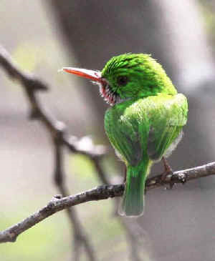
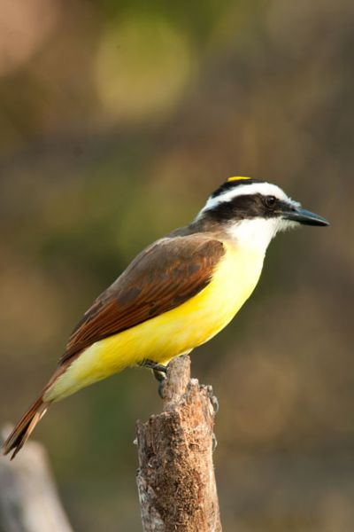
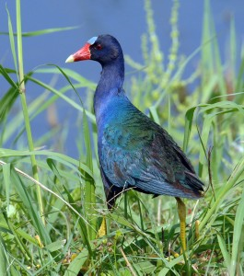
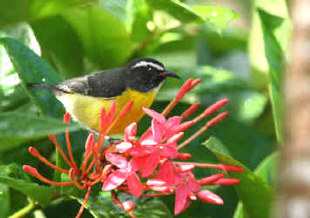
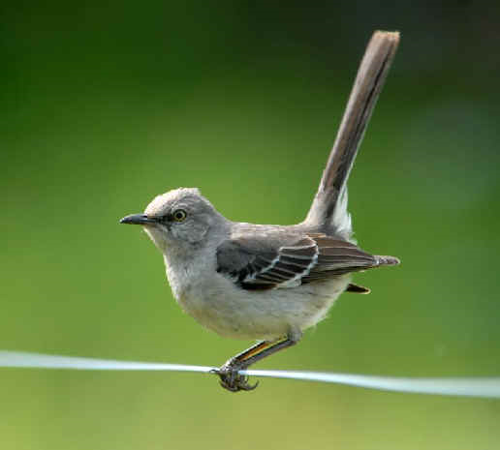
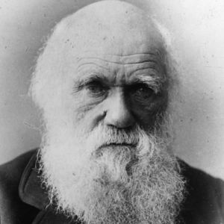
SPECIES
How will you define a biological species?
“ I look at the term species, as one arbitrarily given for the sake of convenience to a set of individuals closely resembling each other”
Charles Darwin
What do you think about Darwin’s comment?

Slide 6
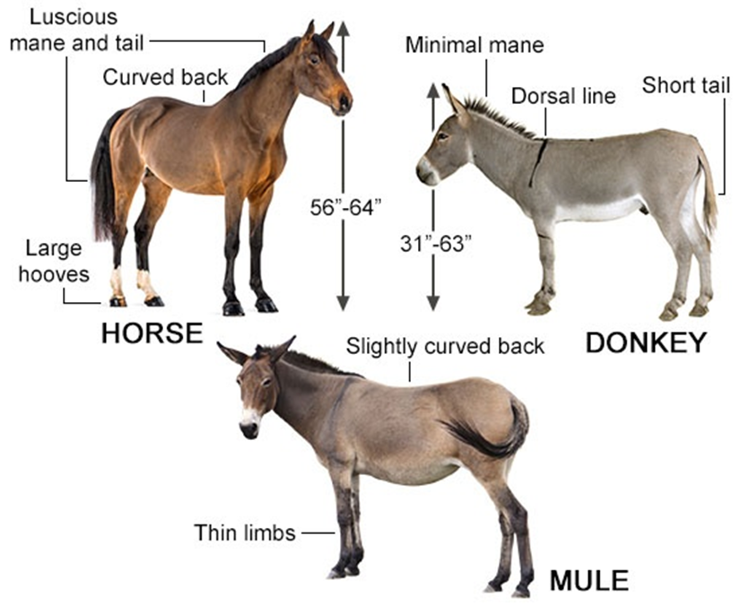
IS THIS A SPECIES – Case 1- Mule?
A mule is the offspring of a male donkey and a female horse.
In contrast, the hinny is the offspring of a male horse and a female donkey.
The mule is easier to breed and larger in size than the hinny.
For these reasons, the mule became an important domesticated animal.
Horses have 64 chromosomes while
Donkeys have 62.
Mules have 63 chromosomes, which cannot evenly divide.
This accounts for the fact that mules are sterile – cannot produce offspring of its own.
Is the mule a separate species from the horse and donkey?

Slide 7
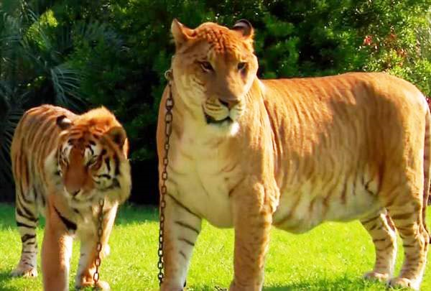
IS THIS A SPECIES – Case 2 – Liger?
A liger is the offspring of a male lion and a female tiger .
In contrast, the tigon is the offspring of a male tiger and a female lion.
These two species do not breed in nature because their habitats are mostly different.
Lions live in open grasslands while
tigers live in forests.
In captivity, it is possible to produce ligers and tigons.
Male ligers are sterile but female ligers are fertile and can be bred to either tigers or lions.
LION
TIGER
Is the liger a separate species from the lion and tiger?
LIGER

Slide 8
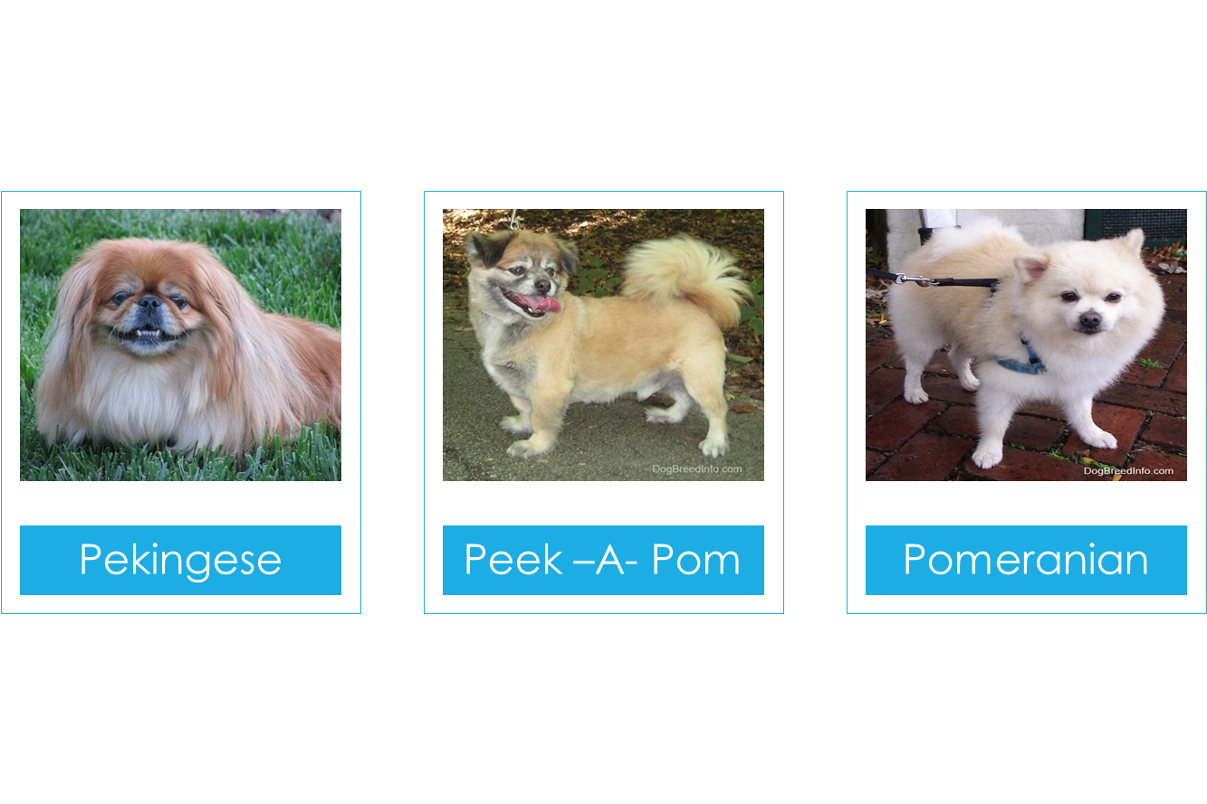
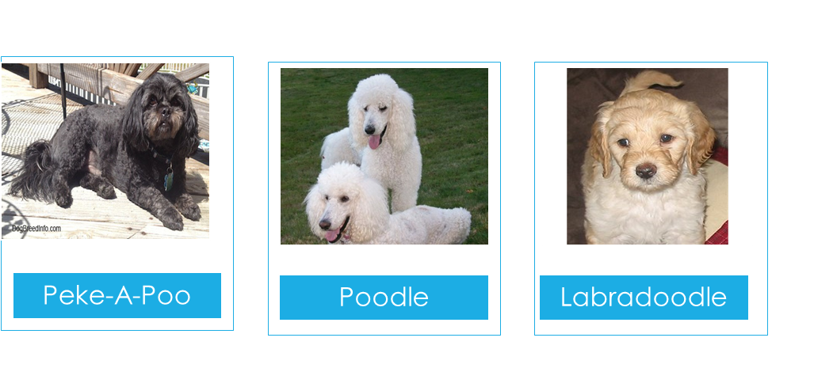
IS THIS A SPECIES – Case 3 – Dogs?
There are a wide variety of domesticated dog breeds.
Most of these are capable of breeding with each other to produce mixed offspring that feature a combination of the traits of the parents.
For example, Poodles and Pekingese can be bred to produce what some have referred to as Pekapoos.
These mixed breeds are healthy and can reproduce with other dogs.
All hybrid dogs are fertile.

Slide 9
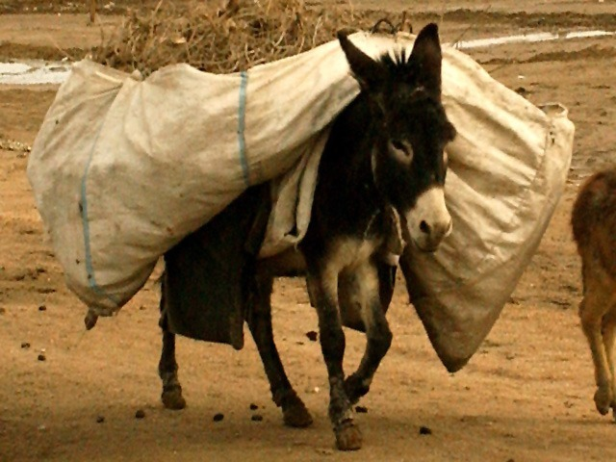
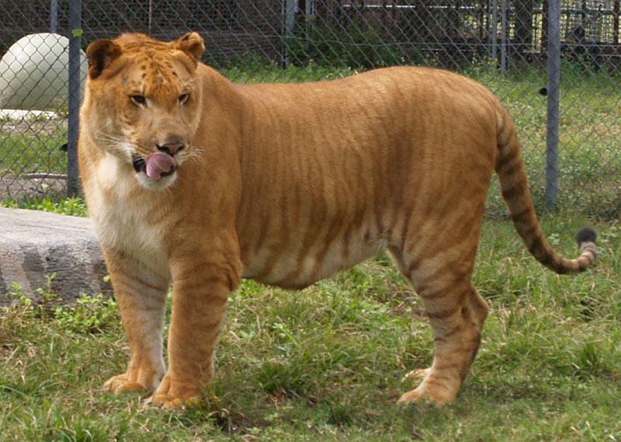
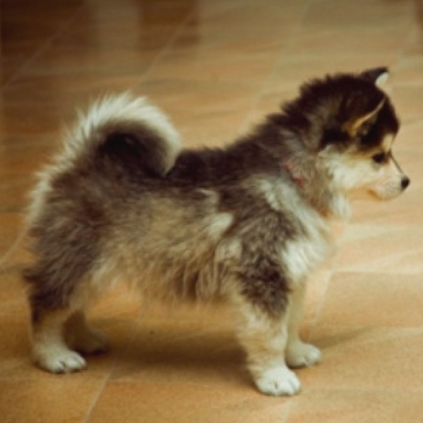
BIOLOGICAL SPECIES CONCEPT
Is a species simply “ a set of individuals closely resembling each other” as Darwin said?
Not according to the Biological species concept:
A species is a group of living organisms which share the same general physical characteristics and can mate with others of the same type to produce viable, fertile offspring.
Scientists use different definitions of species that depend on characteristics such as
Reproduction, morphology and ecology.

Slide 10


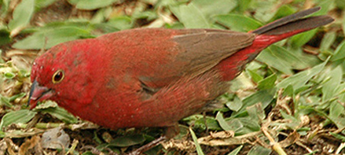
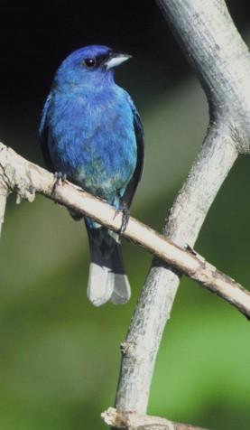
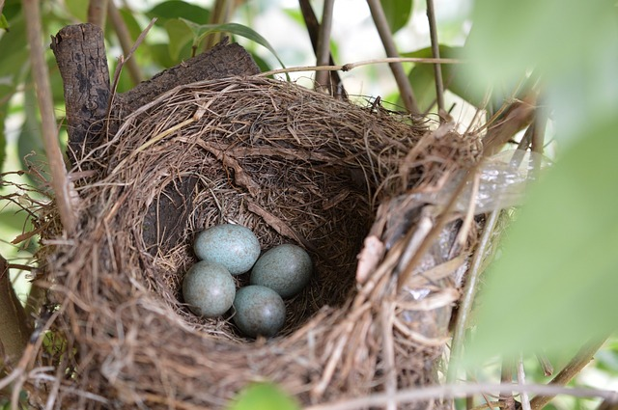
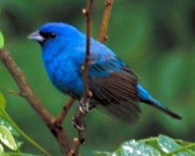
DO WORKSHEET 1
Worksheet 1 has some definitions of a species.
One of them is the Biological Species Concept.
The other definitions might fit the cases 1, 2 and 3 about the mule, liger and dogs.
Read the paragraphs on the indigo birds and answer the questions.
You have 5 minutes.

Slide 11
WORKSHEET 1 – EXPECTED ANSWERS
1. Are the two populations of indigo birds separate species? Why or why not?
The two populations are not separate species because they can still interbreed.
2. Which of the species definitions above is most helpful in deciding if the two populations of indigo birds are separate species?
Species Definition #1 best addresses the species question of the indigo birds
3. What do you predict will happen to these two populations in the future?
Either the two populations will continue to grow more different over time
Or they may lose the ability to interbreed and will be come distinct species.

Slide 12
SPECIATION
Speciation is the formation of a new species or two new species from a common ancestor.
For speciation to occur, the following must take place
  Gene flow between two populations is interrupted
  Genetic differences gradually accumulate between the two populations
  Reproductive isolation evolves – the two populations cannot mate
Speciation can be modeled with diagrams based on how populations become genetically isolated from each other.
Consider the Anoles lizards in the Caribbean.

Slide 13
Go to the websites below and look at the videos
Video 1
http://www.hhmi.org/biointeractive/anole-lizards-example-speciation - animation of lizard speciation
Video 2
http://media.hhmi.org/biointeractive/films/OriginSpecies-Lizards.html - video on Lizards speciation in the Caribbean
Video 3
https://www.youtube.com/watch?v=8yvEDqrc3XE – Speciation an illustrated introduction - Birds

Slide 14
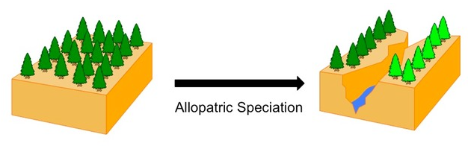

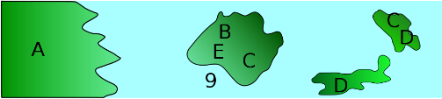
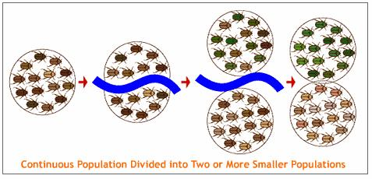
GEOGRAPHIC SEPARATION
RIVER
ISLANDS

Slide 15
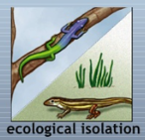
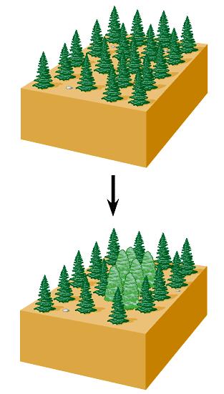
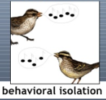
ECOLOGICAL AND BEHAVIOURAL SPECIATION
Ecological speciation occurs when there are barriers to gene flow resulting from the ecology of the area considered.
  different niches/ habitats,
  predators
  competition for resources.
  Example: Anole lizards in the tree/land
Behavioral speciation is seen when species engage in distinct courtship and mating rituals.
  Example birds develop different songs

Slide 16
REPRESENTING SPECIATION – WORKSHEET 2
Geographic Ecological
INSTRUCTIONS:
Complete worksheet 2 with simple diagrams to show a comparison of the two causes of speciation.
Start with one circle to represent an original population.
?
?

Slide 17
Did we achieve today’s objectives?
Can you:
Explain what is meant by the term species with respect to the biological species concept?
2. Describe how a new species is formed –mechanisms of speciation?
(a) Physical geographic separation
(b) Ecological and behavioural differences

Slide 18
Thank you
SPECIES AND SPECIATION – Additional Information
www.biologywithmissamy.weebly.com – Miss Amy’s website
http://evolution.berkeley.edu/evolibrary/article/evo_01 - website on evolution including speciation
http://evoled.dbs.umt.edu/default.htm - Teach evolution and make it relevant!

